Slide 1

The GitHub map
A
Z
Ali Karooni & Lucas Bergeron

Slide 2
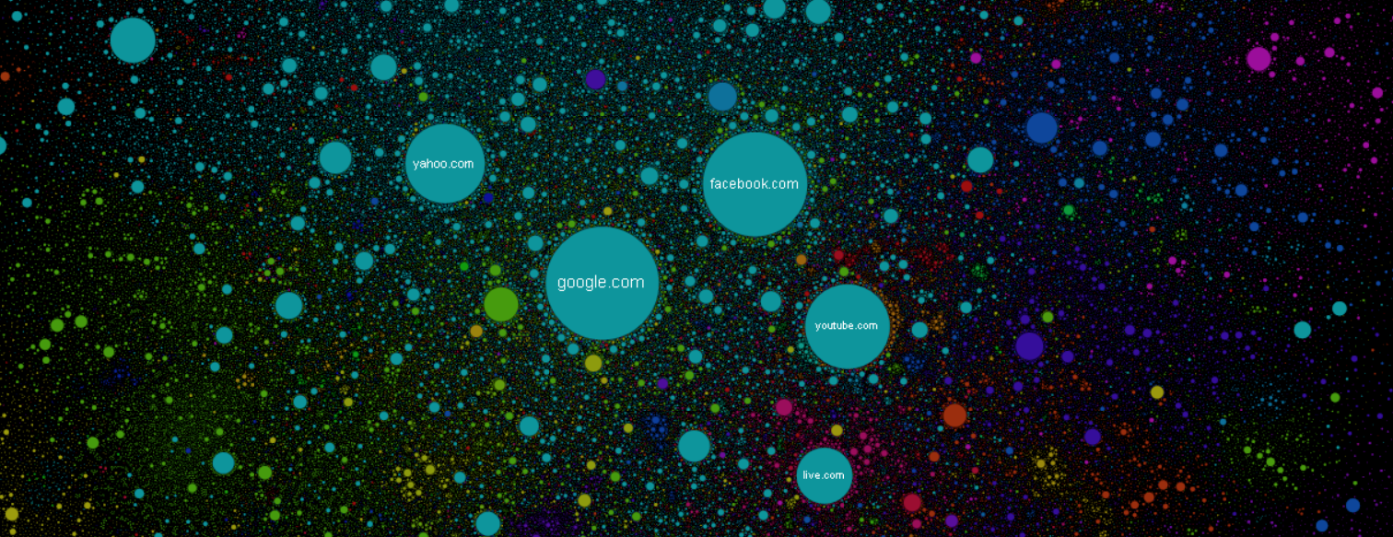
The internet map
2

Slide 3
Our objectives
0.3
0.02
f
0.2
Page ranking
Plotting
A
d
0.01
0.01
D
h
c
C
a
0.08
0.05
0.05
b
g
0.08
e
UPPERCASE = Repositories
lowercase = Users
Number = Weight (proceed with pagerank)
B
0.05
0.05
K
0.05
0.05
3

Slide 4
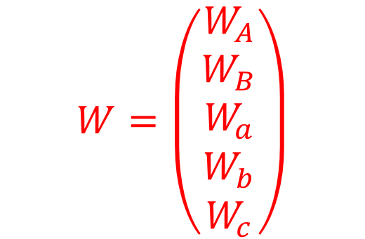


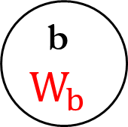
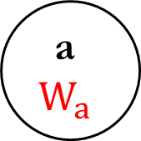
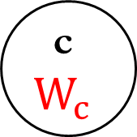
Page Ranking algorithm
a
$$W_{a}$$
A
$$W_{A}$$
6
$$W=\left(\begin{aligned}W_{A} \\ W_{B} \\ W_{a} \\ W_{b} \\ W_{c}\end{aligned}\right)$$
2
b
$$W_{b}$$
1
c
$$W_{c}$$
3
4
B
$$W_{B}$$
4

Slide 5
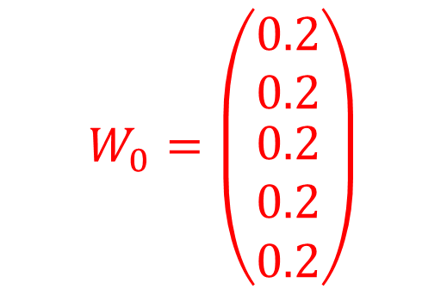
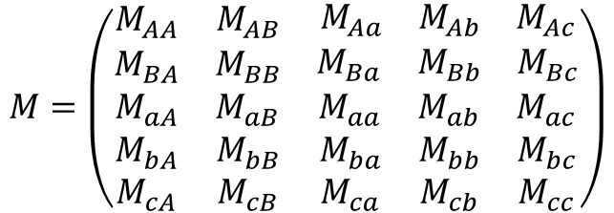
Page Ranking algorithm
a
0.2
A
0.2
< 67%
$$M=\left(\begin{matrix}M_{AA} & M_{AB} & \begin{matrix}M_{Aa} & M_{Ab} & M_{Ac}\end{matrix} \\ M_{BA} & M_{BB} & \begin{matrix}M_{Ba} & M_{Bb} & M_{Bc}\end{matrix} \\ \begin{aligned}M_{aA} \\ M_{bA} \\ M_{cA}\end{aligned} & \begin{aligned}M_{aB} \\ M_{bB} \\ M_{cB}\end{aligned} & \begin{matrix}\begin{aligned}M_{aa} \\ M_{ba} \\ M_{ca}\end{aligned} & \begin{aligned}M_{ab} \\ M_{bb} \\ M_{cb}\end{aligned} & \begin{aligned}M_{ac} \\ M_{bc} \\ M_{cc}\end{aligned}\end{matrix}\end{matrix}\right)$$
100% >
< 11%
< 33%
25% >
22% >
b
0.2
c
0.2
$$W_{0}=\left(\begin{matrix}0.2 \\ 0.2 \\ \begin{matrix}0.2 \\ 0.2 \\ 0.2\end{matrix}\end{matrix}\right)$$
< 43%
< 67%
57% >
75% >
B
0.2
5

Slide 6
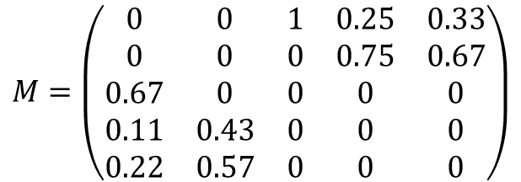
Page Ranking algorithm
a
0.2
A
0.2
< 67%
$$M=\left(\begin{matrix}0 & 0 & 1 & 0.25 & 0.33 \\ 0 & 0 & 0 & 0.75 & 0.67 \\ 0.67 & 0 & 0 & 0 & 0 \\ 0.11 & 0.43 & 0 & 0 & 0 \\ 0.22 & 0.57 & 0 & 0 & 0\end{matrix}\right)$$
100% >
< 11%
< 33%
25% >
22% >
b
0.2
c
0.2
$$W_{0}=\left(\begin{matrix}0.2 \\ 0.2 \\ \begin{matrix}0.2 \\ 0.2 \\ 0.2\end{matrix}\end{matrix}\right)$$
< 43%
< 67%
57% >
75% >
B
0.2
6

Slide 7
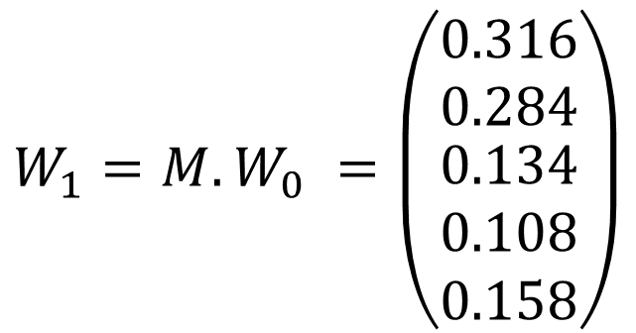
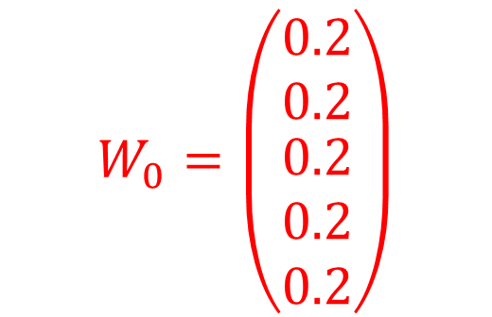
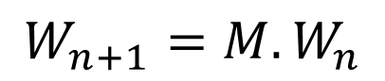
Page Ranking algorithm
$$W_{n+1}=M.W_{n}$$
a
0.2
A
0.2
< 67%
$$W_{0}=\left(\begin{matrix}0.2 \\ 0.2 \\ \begin{matrix}0.2 \\ 0.2 \\ 0.2\end{matrix}\end{matrix}\right)$$
100% >
< 11%
< 33%
0.134
25% >
0.316
22% >
b
0.2
c
0.2
$$W_{1}=M.W_{0} =\left(\begin{matrix}0.316 \\ 0.284 \\ \begin{matrix}0.134 \\ 0.108 \\ 0.158\end{matrix}\end{matrix}\right)$$
< 43%
< 67%
0.108
57% >
0.158
75% >
B
0.2
0.284
7

Slide 8
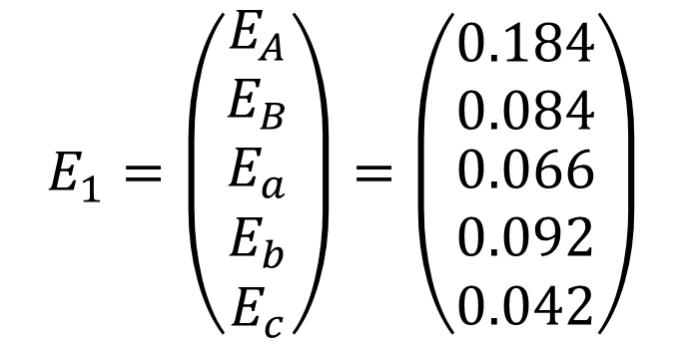
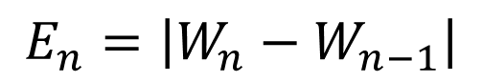
Page Ranking algorithm
$$E_{n}=\left|W_{n}−W_{n−1}\right|$$
a
0.2
A
0.2
< 67%
$$E_{1}=\left(\begin{matrix}E_{A} \\ E_{B} \\ \begin{matrix}E_{a} \\ E_{b} \\ E_{c}\end{matrix}\end{matrix}\right)=\left(\begin{matrix}0.184 \\ 0.084 \\ \begin{matrix}0.066 \\ 0.092 \\ 0.042\end{matrix}\end{matrix}\right)$$
100% >
< 11%
< 33%
0.134
25% >
0.316
22% >
b
0.2
c
0.2
< 43%
< 67%
0.108
57% >
0.158
75% >
B
0.2
Threshold = 0.1
0.284
8

Slide 9
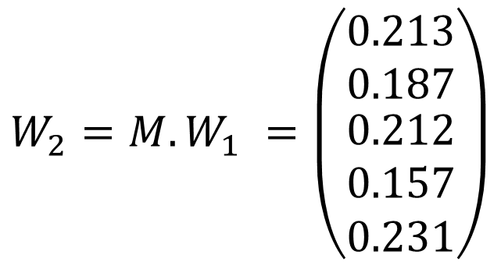
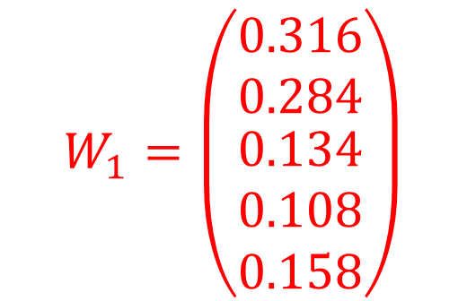
Page Ranking algorithm
$$W_{n+1}=M.W_{n}$$
a
0.2
A
0.2
< 67%
$$W_{1}=\left(\begin{matrix}0.316 \\ 0.284 \\ \begin{matrix}0.134 \\ 0.108 \\ 0.158\end{matrix}\end{matrix}\right)$$
100% >
< 11%
< 33%
0.134
0.212
25% >
0.316
0.213
22% >
b
0.2
c
0.2
$$W_{2}=M.W_{1} =\left(\begin{matrix}0.213 \\ 0.187 \\ \begin{matrix}0.212 \\ 0.157 \\ 0.231\end{matrix}\end{matrix}\right)$$
< 43%
< 67%
0.108
0.157
57% >
0.158
0.231
75% >
B
0.2
0.284
0.187
9

Slide 10
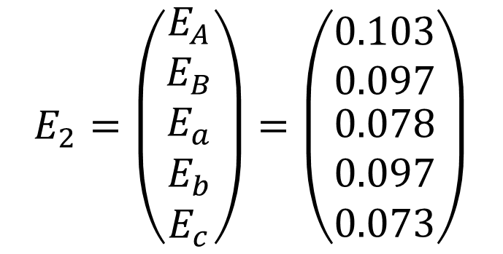
Page Ranking algorithm
$$E_{n}=\left|W_{n}−W_{n−1}\right|$$
a
0.2
A
0.2
< 67%
$$E_{2}=\left(\begin{matrix}E_{A} \\ E_{B} \\ \begin{matrix}E_{a} \\ E_{b} \\ E_{c}\end{matrix}\end{matrix}\right)=\left(\begin{matrix}0.103 \\ 0.097 \\ \begin{matrix}0.078 \\ 0.097 \\ 0.073\end{matrix}\end{matrix}\right)$$
100% >
< 11%
< 33%
0.134
0.212
25% >
0.316
0.213
22% >
b
0.2
c
0.2
< 43%
< 67%
0.108
0.157
57% >
0.158
0.231
75% >
B
0.2
Threshold = 0.1
0.284
0.187
10

Slide 11
Page Ranking with mappers & reducers
Input (links)
Output (weights)
Repo | Email | Commits
A | c@c.com | 2
A | b@b.com | 1
B | b@b.com | 3
A | a@a.com | 6
B | c@c.com | 4
User/Repo | Weight
A | 0.316
B | 0.284
c | 0.158
a | 0.134
b | 0.108
Page Ranking
Process
11

Slide 12
Page Ranking – Step 1
S
Key Value
A a@a.com 6
A b@b.com 2
A [(a@a.com, 6), (b@b.com, 2)]
a@a.com [(A.6)]
b@b.com [(A.2)]
Key Value
A (a@a.com, 6)
a@a.com (A, 6)
A (b@b.com, 2)
b@b.com (A, 2)
_ {key:A. links:{a@a.com:75%, b@b.com:25%}}
_ {key:a@a.com, links:{A:100%}}
_ {key:b@b.com, links:{A:100%}}
Mapper
S
Reducer
S
12

Slide 13
Page Ranking – Step 2
Key Value
_ [{key:A, links:{a@a.com:75%, b@b.com:25%}},
{key:a@a.com, links:{A:100%}},
{key:b@b.com, links:{A:100%}}]
Key Value
{key:A. links:{a@a.com:75%, b@b.com:25%}} 1/3
{key:a@a.com, links:{A:100%}} 1/3
{key:b@b.com, links:{A:100%}} 1/3
S
Reducer
S
13

Slide 14
Page Ranking – Step 3 to 3+N
S
Key Value
…A… 1/3
…a@a.com… 1/3
…b@b.com… 1/3
…a@a.com… [0.25]
…b@b.com… [0.083]
…A… [0.333, 0.333]
Key Value
…a@a.com… 0.25
…b@b.com… 0.083
…A… 0.333
…A… 0.333
…a@a.com… 0.25
…b@b.com… 0.083
…A… 0.666
Mapper
S
Reducer
S
14

Slide 15
Page Ranking – Step 4+N
S
Key Value
…a@a.com… 0.25
…b@b.com… 0.083
…A… 0.666
_ [(…a@a.com…, 0.25),
(…b@b.com…, 0.083),
(…A…, 0.666)]
Key Value
_ (…a@a.com…, 0.25)
_ (…b@b.com…, 0.083)
_ (…A…. 0.666)
…A… 0.666
…a@a.com… 0.166
…b@b.com… 0.083
Mapper
S
Reducer
S
15

Slide 16
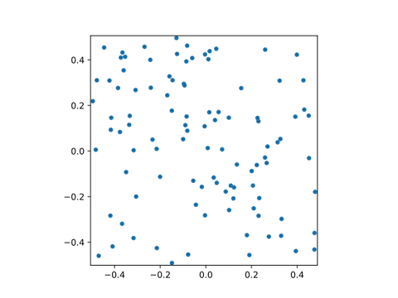
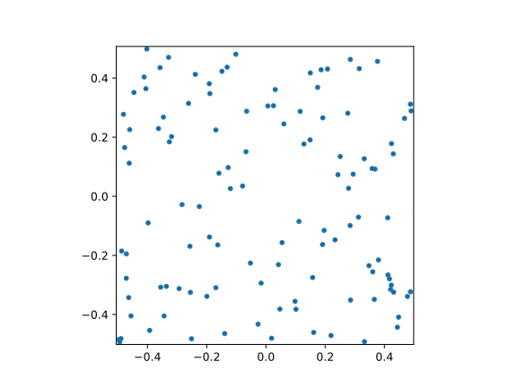
Page Ranking & Plotting results
2 repos, 50 users each with 1 commit
26 repos, 500 users with random commits (1 to 100)
16

Slide 17
How does plotting algorithm works ?
R
r
R
r
r
r
R
R
0
R+4r
0
R+4r
R+2r
R+2r
-r
-r
16

Slide 18
How does plotting algorithm works ?
R
r
R
r
r
r
R
R
0
R+4r
0
R+4r
R+2r
R+2r
-r
-r
16

Slide 19
Thank you !
A
Z
LucBerge/GitHub-map
Ali Karooni & Lucas Bergeron

Slide 20
Page Ranking algorithm – Damping factor
A
0.33
A
0.66
< 50%
100%>
< 100%
50%>
< 50%
100%>
< 100%
50%>
b
0.33
c
0.33
b
0.16
c
0.16
18

Slide 21
Page Ranking algorithm – Damping factor (ε)
80% = ε
80% = ε
A
0.33
A
0.4
< 10%
20%>
< 20%
10%>
< 10%
20%>
< 20%
10%>
b
0.33
c
0.33
b
0.3
c
0.3
80% = ε
80% = ε
80% = ε
80% = ε
19

Slide 22
Thank you !
A
Z
LucBerge/GitHub-map
Ali Karooni & Lucas Bergeron

